Slide 1
C++ Programming Design
Session #6

Slide 2
#6 Objects and Classes
Object-oriented programming reviewing
How to define and implement a class
Public and private class access
Class data members
Class methods (also called class function members)
Creating and using class objects
Class constructors and destructors
const class and const member functions
The this pointer
Creating arrays of objects

Slide 3
OOP (Object-Oriented Programming)
Object
Any entity that has state and behavior is known as an object. It can be physical and logical.
For example: chair, pen, table, keyboard, bike, etc.

Slide 4
OOP (Object-Oriented Programming)
Class
It is a user defined data type, which holds its own data members and member functions, which can be accessed and used by creating an instance of that class.
A class is like a blueprint for an object.

Slide 5




OOP (Object-Oriented Programming)
class Minion
data
Name;
HairColor;
EyeNumber;
……
Abstraction
Encapsulation
GetName();
CountEyeNum();
SetHairColor();
……
Object
Class
manipulation

Slide 6



OOP (Object-Oriented Programming)
Abstraction
Instantiation
Object
Class
Object
In real world
In program world

Slide 7
Classes and Objects: Class declaration
Keyword
class Classname
{
private:
data member;
public:
methods / function member
protected:
};
Class name
Private Member Qualifer
Describing static property of object
Public Member Qualifer
Describing dynamic property of object
Protected Member Qualifer
End of Class

Slide 8
Classes and Objects: Class declaration
class Stock
{
private:
char company[30];
int shares;
double share_val;
double total_val;
void set_tot() { total_val = shares * share_val; }
public:
void acquire(const char * co, int n, double pr);
void buy(int num, double price);
void sell(int num, double price);
void update(double price);
void show();
};
Placed in .h file

Slide 9
Classes and Objects: Class declaration
class Stock
{
char company[30];
int shares;
double share_val;
double total_val;
void set_tot() { total_val = shares * share_val; }
public:
void acquire(const char * co, int n, double pr);
void buy(int num, double price);
void sell(int num, double price);
void update(double price);
void show();
};
Placed in .h file
private by default

Slide 10
Classes and Objects: Member Functions
Member function (method) definitions are much like regular function definitions.
Member functions have two special characteristics:
(1) When you define a member function, you use the scope-resolution operator (::) to identify the class to which the function belongs.
(2) Class methods can access the private components of the class.

Slide 11
Classes and Objects: Member Functions
class Stock
{
private:
char company[30];
int shares;
double share_val;
double total_val;
void set_tot() { total_val = shares * share_val; }
public:
void acquire(const char * co, int n, double pr);
void buy(int num, double price);
void sell(int num, double price);
void update(double price);
void show();
};
Implementing Class Member Function 1
Inline function by default

Slide 12
Classes and Objects: Member Functions
class Stock
{
private:
char company[30];
int shares;
double share_val;
double total_val;
void set_tot() { total_val = shares * share_val; }
public:
void acquire(const char * co, int n, double pr);
void buy(int num, double price);
void sell(int num, double price);
void update(double price);
void show();
};
Implementing Class Member Function 2
void update(double price)
{
share_val = price;
set_tot();
}

Slide 13
Classes and Objects: Member Functions
class Stock
{
private:
char company[30];
int shares;
double share_val;
double total_val;
void set_tot() { total_val = shares * share_val; }
public:
void acquire(const char * co, int n, double pr);
void buy(int num, double price);
void sell(int num, double price);
void update(double price);
void show();
};
Implementing Class Member Function 2
void Stock::update(double price)
{
share_val = price;
set_tot();
}
Placed in .cpp file

Slide 14
Classes and Objects: Member Functions
class Stock
{
private:
char company[30];
int shares;
double share_val;
double total_val;
void set_tot() { total_val = shares * share_val; }
public:
void acquire(const char * co, int n, double pr);
void buy(int num, double price);
void sell(int num, double price);
void update(double price);
void show();
};
Implementing Class Member Function 2
inline void Stock::show()
{
std::cout << "Company: " << company
<< " Shares: " << shares << ‘\n’
<< " Share Price: $" << share_val
<< " Total Worth: $" << total_val << ‘\n’;
}

Slide 15
Classes and Objects: .h file
// stock00.h -- Stock class interface
// version 00
#ifndef STOCK00_H_
#define STOCK00_H_
#include <string>
class Stock // class declaration
{
private:
std::string company;
long shares;
double share_val;
double total_val;
void set_tot() { total_val = shares * share_val; }
public:
void acquire(const std::string & co, long n, double pr);
void buy(long num, double price);
void sell(long num, double price);
void update(double price);
void show();
}; // note semicolon at the end
#endif

Slide 16
Classes and Objects: .cpp file
// stock00.cpp -- implementing the Stock class
// version 00
#include <iostream>
#include "stock00.h "
…
…
…
void Stock::update(double price)
{
share_val = price;
set_tot();
}
…
…

Slide 17
Classes and Objects: Object Definition
Three ways of object definition (Stock as example)：
(1) Object definition after class declaration：
Stock kate, joe;
(2) Class declaration and object definition simultaneously：
class Stock{…} kate, joe;
(3) Object definition of anonymous class:
class {…} kate, joe;

Slide 18
Classes and Objects: Using Objects
Using objects directly or by reference:
kate.show();
Using objects by pointers to objects：
(1) Object pointer definition：
Stock kate;
Stock * s =&kate;
(2) Using objects by pointers：
s->show();

Slide 19
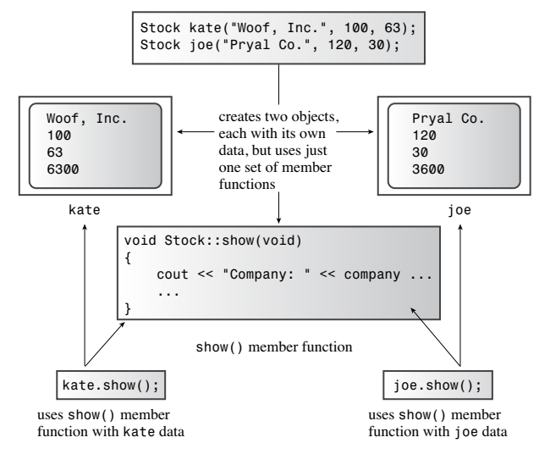
Classes and Objects: Using Objects
1
2
3
4

Slide 20
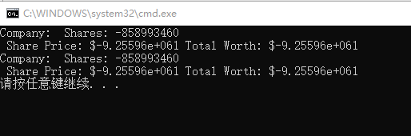
Classes and Objects: Problem
int main()
{
Stock kate, joe;
kate.show();
joe.show();
return 0;
}

Slide 21
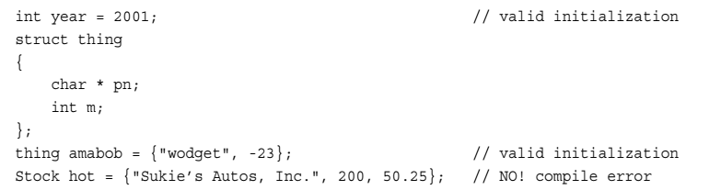
Class Constructors: Object initialization

Slide 22
Class Constructors: Object initialization
To create an object from a class, you will have to call a constructor.
The constructor is to assign default values to you freshly created object or allow a user to assign them as he wants.
A constructor is a special member function of a class which initializes objects of a class.

Slide 23
Class Constructors: Object initialization
A constructor is different from normal functions in following ways:
(1)Constructor has same name as the class itself
(2)Constructors don’t have return type
(3)A constructor is automatically called when create object(instance of class).
(4)If we do not specify a constructor, C++ compiler generates a default constructor (expects no parameters and has an empty body).

Slide 24
Class Constructors: Default Constructors
1)A default constructor is a constructor that is used to create an object when you don’t provide explicit initialization values.
That is, it’s a constructor used for declarations like this:
Stock kate, joe;
2)For the Stock class, the default constructor would look like this:
Stock::Stock( ) { }

Slide 25
Class Constructors: Default Constructors
3) A curious fact about default constructors is that the compiler provides one only if you don’t define any constructors.
After you define any constructor for a class, the responsibility for providing a default constructor for that class passes from the compiler to you.

Slide 26
Class Constructors: Default Constructors
For example:
If you provide a nondefault constructor, such as
Stock(const string & co, long n, double pr)
and don’t provide your own version of a default constructor, then a declaration like:
Stock stock1;

Slide 27
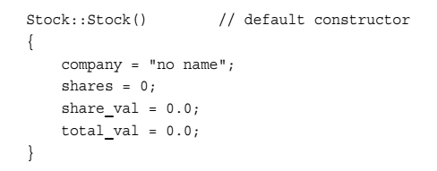
Class Constructors: Default Constructors
4) You can have only one default constructor.
A user-provided default constructor typically provides
implicit initialization for all member values.
For example:

Slide 28
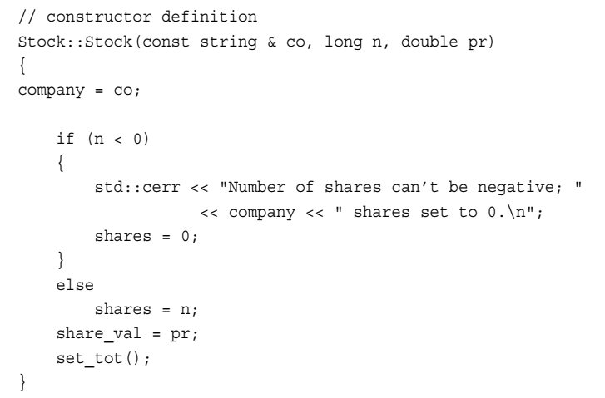
Class Constructors: Overloading

Slide 29
Class Constructors: Using Constructors
Stock first; // calls default constructor implicitly
Stock first = Stock(); // calls it explicitly
Stock *prelief = new Stock; // calls it implicitly
Stock first("Concrete Conglomerate"); // calls constructor
Stock second(); // declares a function

Slide 30

Class Constructors: C++11
Stock::Stock(const std::string & co, long n = 0, double pr = 0.0);
Stock::Stock();
The brace contents must match the argument list of a constructor !

Slide 31
Class Destructors
When you use a constructor to create an object, the program undertakes the responsibility of tracking that object until it expires.
At that time, the program automatically calls a special member function ‘destructor’.

Slide 32
Class Destructors
The destructor should clean up any debris, so it actually serves a useful purpose.
For example:
If your constructor uses new to allocate memory, the destructor should use delete to free that memory.

Slide 33
Class Destructors: Definition
Destructors have same name as the class preceded by a tilde ~
Destructors don’t take any argument and don’t return anything.
Example:
~Stock();

Slide 34
Class Destructors: Definition
(1)Stock::~Stock()//Default destructor
{
}
(2) Stock::~Stock() // User-defined destructor
{
cout << "Bye, " << company << "!\n";
}

Slide 35
const Object and Member Functions
(1) const Object：
Consider the following codes:
const Stock land = Stock("Kludgehorn Properties");
land.show();
(2) const Object only calling to const Member Functions
(3) const Member Functions Declaration and Definition:
void show() const; //Declaration
and
void Stock::show() const{ //Definition
std::cout << "Company: “…….
}

Slide 36
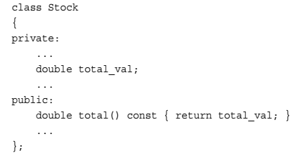
this Pointer
How do you provide the member function with two objects to compare, that is, topval() ?

Slide 37
this Pointer
Implementation of topval() :
const Stock & Stock::topval(const Stock & s) const {
}

Slide 38
this Pointer
Implementation of topval() :
const Stock & Stock::topval(const Stock & s) const { if (s.total_val > total_val) return s; // argument object
}

Slide 39
this Pointer
Implementation of topval() :
const Stock & Stock::topval(const Stock & s) const { if (s.total_val > total_val) return s; // argument object
else
return ?????; // invoking object
}

Slide 40
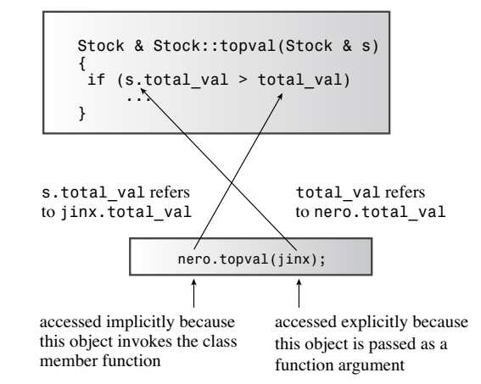
this Pointer

Slide 41
this Pointer
Each member function, including constructors and destructors, has a this pointer.
The special property of the this pointer is that it points to the invoking object.
If a method needs to refer to the invoking object as a whole, it can use the expression *this.

Slide 42
this Pointer: An explanation
For example, the following function prototypes:
const Stock & Stock::topval(const Stock & s) const
const Stock & Stock::topval(const Stock & s, Stock * this) const
AND when function callings:
nero.topval(jinx);
nero.topval(jinx, & nero);

Slide 43
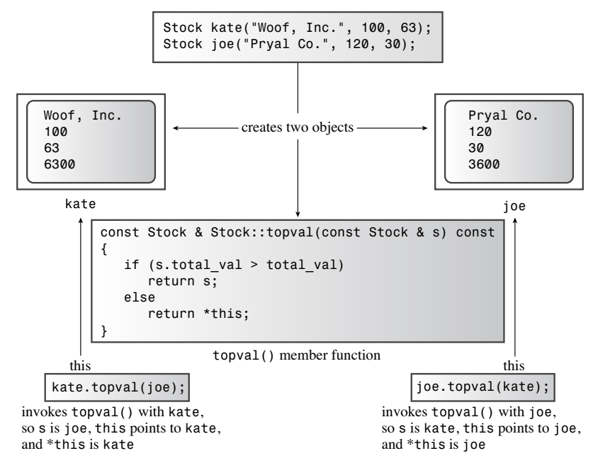
this Pointer
1
2
this->total-val
3
4

Slide 44
this Pointer: Another usage
class Stock
{
private:
char company[30];
int shares;
double share_val;
double total_val;
void set_tot() { total_val = shares * share_val; }
public:
void acquire(const char * co, int n, double pr);
void buy(int num, double price);
void sell(int num, double price);
void update(double price);
void show();
};
void Stock::update(double price)
{
share_val = price;
set_tot();
}

Slide 45
this Pointer: Another usage
class Stock
{
private:
char company[30];
int shares;
double share_val;
double total_val;
void set_tot() { total_val = shares * share_val; }
public:
void acquire(const char * co, int n, double pr);
void buy(int num, double price);
void sell(int num, double price);
void update(double share_val);
void show();
};
void Stock::update(double share_val)
{
share_val = share_val;
set_tot();
}

Slide 46
this Pointer: Another usage
class Stock
{
private:
char company[30];
int shares;
double share_val;
double total_val;
void set_tot() { total_val = shares * share_val; }
public:
void acquire(const char * co, int n, double pr);
void buy(int num, double price);
void sell(int num, double price);
void update(double share_val);
void show();
};
void Stock::update(double share_val)
{
this->share_val = share_val;
set_tot();
}

Slide 47
An Array of Objects
(1) Define an array of objects:
Stock mystuff[4];
(2) Use array of objects:
mystuff[0].update();
(3)Initialize array of objects by calling constructors:
Stock stocks[10] = {
Stock("NanoSmart", 12.5, 20),
Stock(),
Stock("Monolithic Obelisks", 130, 3.25),
};

Slide 48
Class Scope
(1) Class scope applies to names defined in a class.
(2) Items that have class scope are known within the class but not outside the class.
(3) You can use the same class member names in different classes without conflict.

Slide 49

Class Scope
(4) Class scope means you can’t directly access members of a class from the outside world, even for public function members.

Slide 50
Class Scope Constants
class Bakery
{
private:
const int Months = 12;
double costs[Months];
...
}

Slide 51
Class Scope Constants
class Bakery
{
private:
enum {Months = 12};
double costs[Months];
...
}

Slide 52
Class Scope Constants
class Bakery
{
private:
static const int Months = 12;
double costs[Months];
...
}

